Slide 1

Object Oriented Programming with Java
Day 2

Slide 2
Declaring and Using Constants and Variables
Constant
Cannot be changed while program is running
Literal constant
Value taken literally at each use
Numeric constant
As opposed to a character or string constant
Unnamed constant
No identifier is associated with it

Slide 3
Declaring and Using Constants and Variables
Variable
A named memory location
Used to store a value
Can hold only one value at a time
Its value can change
Data type
A type of data that can be stored
How much memory an item occupies
What types of operations can be performed on data

Slide 4
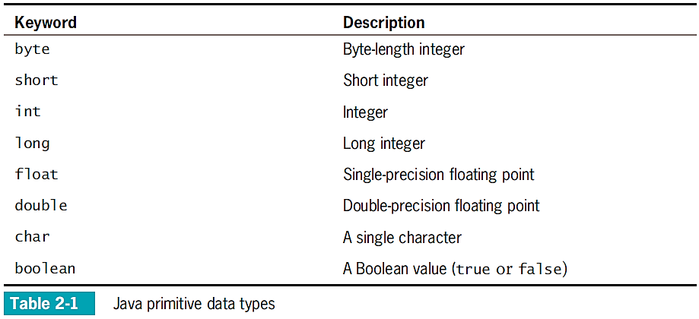
Declaring and Using Constants and Variables
Primitive type
A simple data type (Java provides for EIGHT of these)
Reference (Object) types
More complex data types (next chapter)

Slide 5
Declaring Variables
Name variables
Use naming rules for legal class identifiers (see Chapter 1 for reference)
Conventionally begin with lowercase letters to distinguish them from class names.
Variable declaration
A statement that reserves a named memory location
Includes:
Data type
Identifier that is the variable’s name
Optional assignment operator and assigned value (if you want the variable to contain an initial value)
Ending semicolon

Slide 6
Declaring Variables
Assignment operator
The equal sign (=)
The value to the right is assigned to the variable on the left int myAge = 25;
Initialization
An assignment made when declaring a variable
Assignment
An assignment made later in your code after a variable is declared myAge = 41;

Slide 7
Declaring Variables
Declare multiple variables of the same type in separate statements on different lines.
int myAge = 25;
int yourAge = 19;
(some programmers will declare multiple variables in the same statement if their purpose is closely related)
When declaring variables of different types, you must use a separate statement for each type.

Slide 8
Declaring Named Constants
A named constant (aka “symbolic constant”):
Should not change during program execution.
Has a data type, name, and value.
Has a data type preceded by the keyword final.
Can be assigned a value only once.
Conventionally is given identifiers using all UPPERCASE letters with underscores separating words.

Slide 9
Declaring Named Constants
Reasons for using named constants:
Support application design
Make programs easier to read and understand
Reduce typographical errors
Stand out as separate from variables

Slide 10
The Scope of Variables and Constants
Scope
The area in which a data item is visible to a program, and in which you can refer to it using its simple identifier
A variable or constant is in scope from the point it is declared until the end of the block of code where the declaration lies

Slide 11
Concatenating Strings to Variables and Constants
print() or println() statement
Use alone or in combination with a String
Concatenated
A numeric variable is concatenated to a String using the plus sign
The entire expression becomes a String
The println() method can accept a number or String objects.

Slide 12
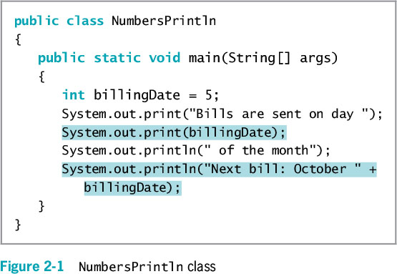
Concatenating Strings to Variables and Constants

Slide 13
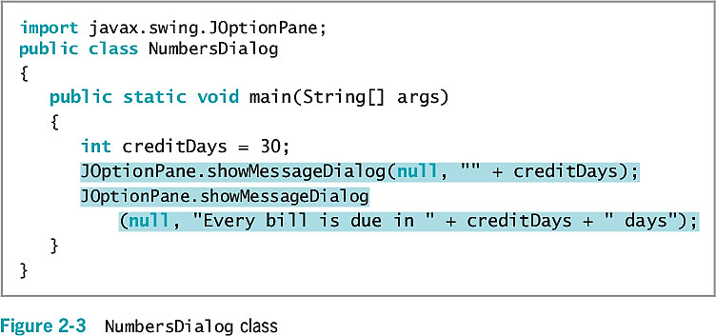
Concatenating Strings to Variables and Constants

Slide 14
Pitfall: Forgetting That a Variable Holds One Value at a Time
Each constant can hold only one value for the duration of the program
Use a third variable to switch values of two variables
See video: Declaring Variables & Constants

Slide 15
Exercise
Work through the 2 exercises on Pages 62-64 in the Java Programming textbook.

Slide 16
Learning About Integer Data Types
int data type
Stores an integer, or whole number
Value from –2,147,483,648 to +2,147,483,647
Variations of the integer type
byte
short
long
Choose appropriate types for variables

Slide 17
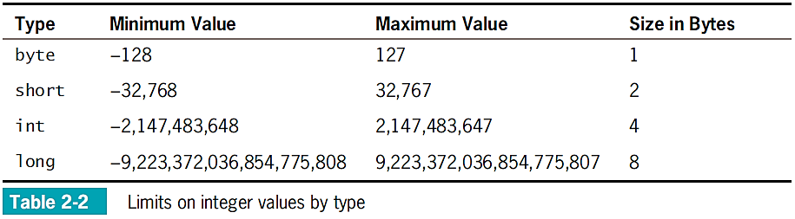
Learning About Integer Data Types

Slide 18
Using the boolean Data Type
Boolean logic
Based on true-or-false comparisons
boolean variable
Can hold only one of two values
true or false
boolean isPayday = false;
Relational operator (comparison operator)
Compares two items

Slide 19
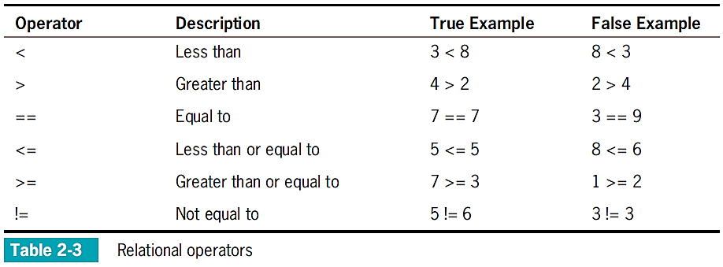
Using the boolean Data Type

Slide 20
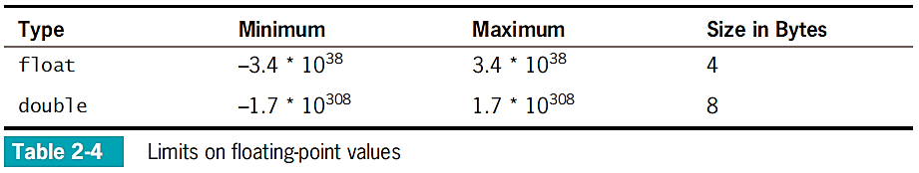
Learning About Floating-Point Data Types
Floating-point number
Contains decimal positions
Floating-point data types
Float (up to 6 or 7 significant digits)
Double (14 or 15 significant digits)
Significant digits
Refers to mathematical accuracy

Slide 21
Using the char Data Type
char data type
Holds any single character
Place constant character values within single quotation marks
char myMiddleInitial = 'M';
String
A built-in class
Stores and manipulates character strings
String value is written between double quotation marks

Slide 22
Using the char Data Type
Escape sequence
Begins with a backslash followed by a character
Represents a single nonprinting character
char aNewLine = '\n';
To produce console output on multiple lines in the command window, use one of these options:
Use the newline escape sequence
Use the println() method multiple times

Slide 23
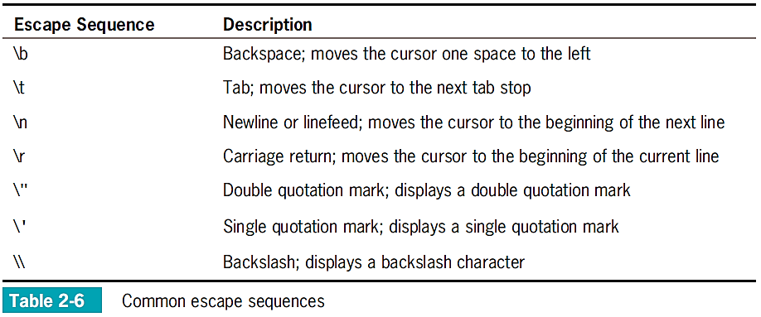
Using the char Data Type

Slide 24
Using the Scanner Class to Accept Keyboard Input
System.in object
Standard input device
Normally the keyboard
Access using the Scanner class
Scanner object
Breaks input into units called tokens

Slide 25
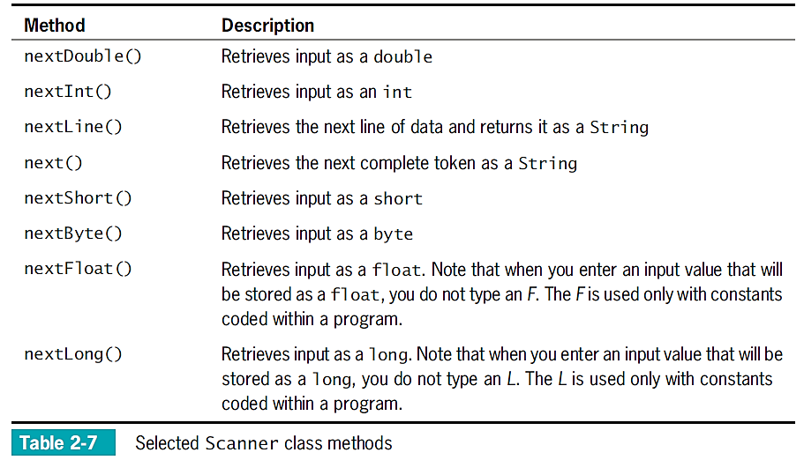
Using the Scanner Class to Accept Keyboard Input

Slide 26
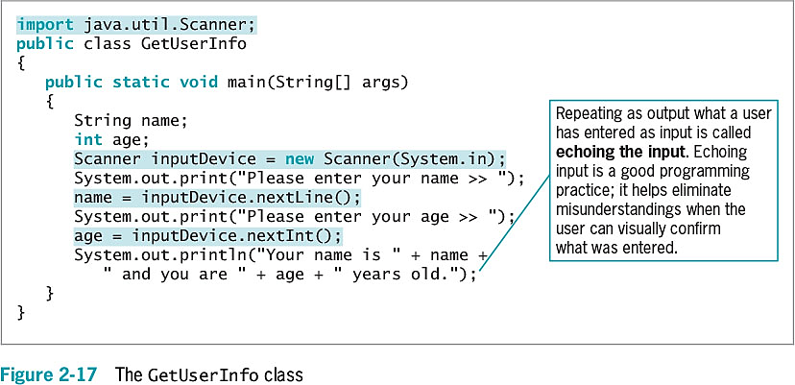
Using the Scanner Class to Accept Keyboard Input

Slide 27
Pitfall: Using nextLine() Following One of the Other Scanner Input Methods
There is a problem when using one numeric Scanner class retrieval method or next()method before using the nextLine()method
Keyboard buffer
Location in memory that stores all keystrokes, including Enter
To avoid issues, add an extra nextLine()method call to retrieve the abandoned Enter key character after numeric or next() inputs

Slide 28
Using the JOptionPane Class to Accept GUI Input
Dialog boxes used to accept user input:
Input dialog box
Confirm dialog box

Slide 29
Using Input Dialog Boxes
Input dialog box
Asks a question
Provides a text field in which the user can enter a response
showInputDialog() method
Six overloaded versions
Returns a String representing a user’s response
Prompt
A message requesting user input

Slide 30
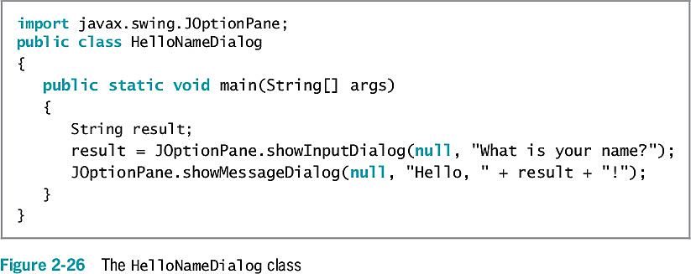
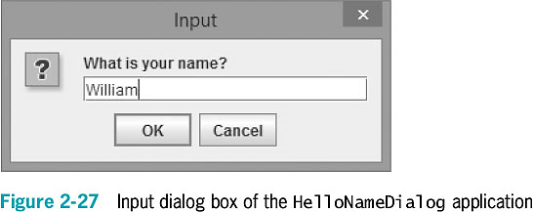
Using Input Dialog Boxes

Slide 31
Using Input Dialog Boxes
showInputDialog()
One version requires four arguments:
Parent component
Message
Title
Type of dialog box
Convert String to int or double
Use methods from the built-in Java classes Integer and Double

Slide 32
Using Input Dialog Boxes
Type-wrapper classes
Each primitive type has a corresponding class contained in the java.lang package
Include methods to process primitive type values
Integer.parseInt()
Double.parseDouble()

Slide 33
Using Confirm Dialog Boxes
Confirm dialog box
Displays the options Yes, No, and Cancel
showConfirmDialog() method in JOptionPane class
Four overloaded versions are available
Returns integer containing either:
JOptionPane.YES_OPTION
JOptionPane.NO_OPTION
JOptionPane.CANCEL_OPTION

Slide 34
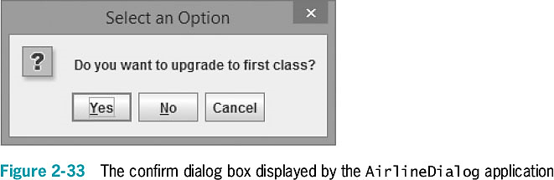
Using Confirm Dialog Boxes
You can create a confirm dialog box with five arguments:
Parent component
Prompt message
Title
Integer that indicates which option button to show
Integer that describes the kind of dialog box

Slide 35
Performing Arithmetic
Standard arithmetic operators
Perform calculations with values in programs
Operand
A value used on either side of an operator
Integer division
Involves integer constants or integer variables
The result is an integer
Any fractional part of the result is lost

Slide 36
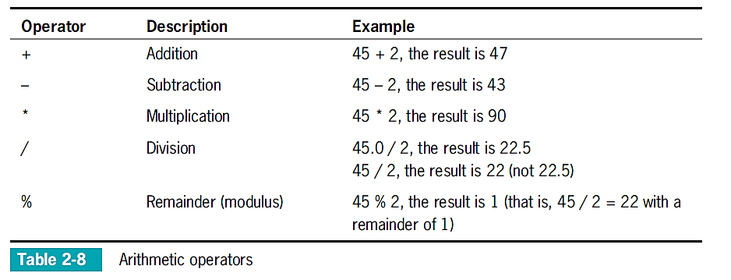
Performing Arithmetic

Slide 37
Associativity and Precedence
Operator precedence
The rules for the order in which parts of mathematical expressions are evaluated
First multiplication, division, and remainder (modulus), then addition or subtraction

Slide 38
Writing Arithmetic Statements Efficiently
Avoid unnecessary repetition of arithmetic statements
Example of inefficient calculation:
stateWithholding = hours * rate * STATE_RATE;
federalWithholding = hours * rate * FED_RATE;
Example of efficient calculation:
grossPay = hours * rate;
stateWithholding = grossPay * STATE_RATE;
federalWithholding = grossPay * FED_RATE;

Slide 39
Pitfall: Not Understanding Imprecision in Floating-Point Numbers
Integer values are exact, but floating-point numbers frequently are only approximations
Imprecision leads to several problems
Floating-point output might not look like what you expect or want
Comparisons with floating-point numbers might not be what you expect or want

Slide 40
Understanding Type Conversion
Arithmetic with variables or constants of the same type:
The result of arithmetic retains the same type.
Arithmetic operations with operands of unlike types:
Java chooses the unifying type for the result.
Unifying type
The type to which all operands in an expression are converted for compatibility.

Slide 41
Automatic Type Conversion
Automatically converts nonconforming operands to the unifying type
Order for establishing unifying types between two variables (highest to lowest):
double
float
long
int
(short and byte are automatically converted to int when used in expressions)

Slide 42


Automatic Type Conversion
This will not compile because hoursWorked multiplied by payRate will be converted to a double. The int variable grossPay won’t accept it.
This will work since when hoursWorked multiplied by payRate is converted to a double. The variable grossPay is also of the double data type.

Slide 43

Explicit Type Conversions
Type casting
Forces a value of one data type to be used as a value of another data type
Cast operator
Place desired result type in parentheses
Using a cast operator is an explicit conversion
You do not need to perform a cast when assigning a value to a higher unifying type

Slide 44
Don’t Do It
Don’t use a single equal sign (=) in a Boolean comparison for equality
Don’t forget that when a String and a numeric value are concatenated, the resulting expression is a string
Don’t forget to consume the Enter key after numeric input using the Scanner class when a nextLine()method call follows

Slide 45
Summary
Variables
Named memory locations
Primitive data types
Standard arithmetic operators for integers:
+, _, *, /, and %
Boolean type
true or false value
Relational operators:
>, <, ==, >=, <=, and !=

Slide 46
Summary
Floating-point data types
float
double
char data type
Scanner class
Access keyboard input
JOptionPane
Confirm dialog box
Input dialog box

